Slide 1
Startup Pitch.
Institute of Engineers, Karachi.
We’re very thankful to IEP Karachi who gave us an opportunity and made us able to present this.

Slide 2
Who We Are?
We were running a business, WebWayOut providing web development & corporate identity
Designing services to ecommerce sector in Pakistan along with digital marketing since 2012
Afshan Samad
Masters in International Relations
University of Karachi
Syed Abdullah B.E. Mechanical NED University

Slide 3
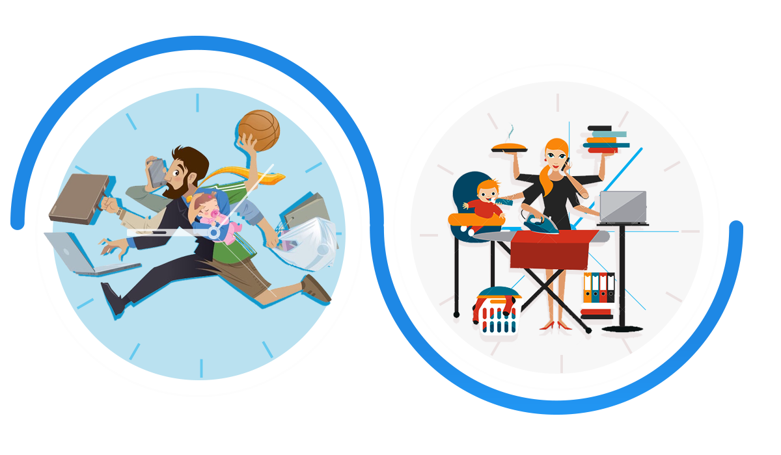
Do You Love Laundry?
Men & women are passing busy life single person have to look, office, shopping, cooking, house chores and laundry.

Slide 4
You never experienced it, before.
WashEz
Weekends are meant for Family!
01
02
WashEz is an online laundry & dry cleaning service in Karachi. In addition to our premium dry clean and laundry service, we offer an excellent ironing service, wash & fold service and duvet cleaning. Overall, we are your personal dry cleaning and laundry collection and delivery service who deliver to your preferred location.
03
Book using mobile app or website
We pickup from your door step
Your clean laundry is delivered

Slide 5
Opportunity and Value Proposition
Laundry market largely dominated for Upper Class the prices are not set lower middle class.
Startup in laundry space is trying to fill the gap by offering comprehensive solution at affordable prices
Offline Market
Maid Availability
Reliability
Customer Oriented
This sector is dominated by 90% offline suppliers.
Difficulty in getting Maids & Servants easily in city.
Offline players of sector, are Unreliable & Unorganized.
Services accelerated owing Smartphone & internet
One Stop Solution
Busy Schedules
Maintenance Free
Turn Around
Offline players are not providing every service.
Its hard to get clothes back on-time from Laundromats.
Why you maintain a separate liability for none.
Offline players give a higher turn around time.

Slide 6
Weekends are meant for family.
DryCleaning

Slide 7
It is very convenient and fast.
Steam Press
Iron Solution
With latest technology steam press can easily iron every type of clothes in just half of a minute. It also add life to clothes.

Slide 8
You never experienced it, before.
Wash
And Fold
Most Economized service, for lower budget families, bachelors and for those who just want to try us.
This service is very economical, which can give an extra life to your clothes with color contrast of your clothes as it is.

Slide 9
Time Efficient
We assure timely pickup and delivery, to make the trust of client at higher in scale.

Slide 10
At your
Fingertips
Any one can order easily via our precisely designed mobile app or by using our website with perfectly suitable and designed user interface for our website.
By using mobile app or website every order is easily traceable by customer, along with SMS alerts on your mobile.

Slide 11
More Reliable
We at WashEz care about you. We care about your clothes. Which is why, we treat each and every one of your garments as if it were one of our own.

Slide 12
Our Main Focus
We have researched on, our market. We categorized our audience according to age group.
Help 24/7
Marketing
Verified Customers
Trust Building
We will provide a best 24/7 Call center service to entertain our clients all the time. .
Our focus on marketing is moderate to target customers as per our capacity.
We would have verified customers by calls & SMS to protect from spam.
We would strongly take actions on customers feed back and complaints to build their trust.

Slide 13
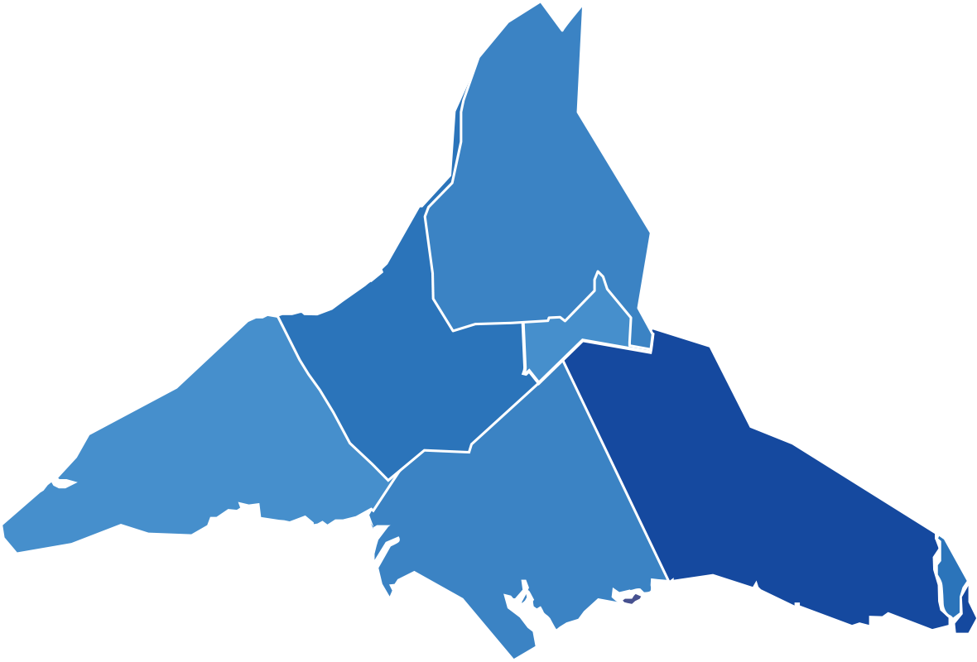
Our Market Size
We have researched on our, market size to get our growth estimates. We got these stats from Facebook & Careem
We have 27 Million people in Karachi, about 40% of this are using internet. However we expect only 0.01% so we get 0.27 Million target audience and get 0.1% converted, we get 27,000 customer monthly
26%
50%
74%
60%
Female
Potential Client
Male
Potential Client

Slide 14
Our Marketing Strategy
We will market our brand by using, experimental strategy. Its our channel to peruse our targets.
01
Info Graphic Video
We will get a info graphic explanatory video to demonstrate our whole process.
02
Facebook Marketing
Using Facebook we will target specified age group and will viral our video in Karachi.
03
Branded SMS
By using branded SMS we can target people according to their ages and areas of living.
04
Newspapers
We can give a feel of brand by advertising in newspaper to with QR code to install mobile app.
05
Live Events
We can target no of people in mall, universities, offices & on roads.

Slide 15
It’s a time to invest because you are in , zero competitor zone.
So-called
Competitors
Although we are in no competitors zone, but we can look into those who could be our future competitors with limited scope.
Dhobi online
40%
Laundry Walaz
25%
Cleanry
10%
Snowhite
20%
Dhobisaab
20%

Slide 16
Our Business Model
Let us describe some numbers, Financial Methodology is very essential for the business.
WashEz revenue is generating from customers’ payments while expenses would go to laundry agencies & salary disbursment.
20%
40%
20%
80%
Profit
Out-Sourcing
Re-Market
Growth

Slide 17
Revenue & Proposed Profit
Letterpress next level trust fund, before they sold out +1 meh gluten-free locavore tacos PBR&B tofu.
50%
13500 customers ordered once in month.
WashEz revenue can be calculated at worst. All expenses would be subtracted and we would get net profit.
150
Min order cost Rs. 150 only.
100
Rs 100 will be charged for delivery
2.362 M
0.12 M
10%
Generated Revenue
Proposed Profit
10% of 13500 will pay more Rs. 150 for free delivery service.
1%
1% of 13500 will order more than Rs. 1000.

Slide 18
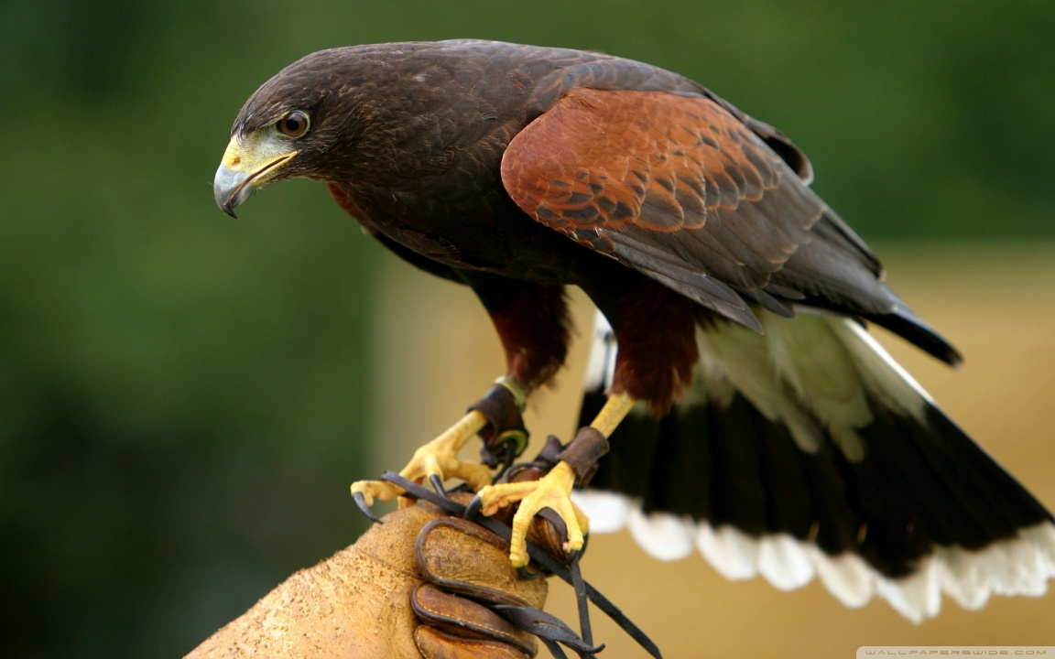
Bird
In hand
Our Key Resources.

Slide 19
Laundry
Pickup
Development
Marketing
Designing
Laundry Partner
Delivery Partner
Mobile App & Website
Social & Traditional
UI & UX for App & Web
We have done agreement with Classic Dry Cleaners
We have done agreement with Delivery Charlie for pickup and deliveries
We are having 5years experience in development
We have digital Marketing & traditional marketing experience
Experienced designers to get user experience awesome

Slide 20
Mobile App First Look
We are disclosing our designed mobile app for WashEz as we are doing good in this area too.
Wallets
Rating to Service
To manage payments and billings easily via mobile app.
Mobile app will have complete capacity to rate service, agents and dry cleaning
Help
Coupons
Mobile app will have complete guide to help customers so that they can easily understand that how it works?
Mobile app will have coupons to redeem so that we can give various discounts to customers

Slide 21
Washez is Going to Launch BETA
We have done our research work and now in development phase
Day & Date
Our Beta is going to be launch on Friday 20th October 2017
Target
For this we will target the customers in institute and malls
Presentation
We will continue our marketing via social media and explanatory video
MobileApp Launch
After beta we will launch our mobile app on 1st Jan 2018 with full strengths.

Slide 22
Call to Action
It is very important to have, any plan and follow that plan with a passion to build your career and recognition.
You must start whatever you can and support others.
Feedback on idea and suggestion to improve.
Active support so can bring better service.
Register with us today get discounts on launch (Register on our website or message us at FaceBook)

Slide 23
Thanks For Watching!
We would request judges & guests to ask their questions and give us suggestions as well.

